Slide 1



WHAT ARE WE WATCHING TONIGHT?
Christian Albertini
Le Nguyen
Richard Roop
Group 1

Slide 2
Executive Summary
Do you ever wonder which streaming service is right for your needs?
Kids?
Quality of content?
Newest content?
Our project was reviewing data from streaming services to identify data trends-
The focus was on four primary services:
Netflix
Hulu
Amazon Prime
Disney Plus

Slide 3
Project Goals
Which is the best service for families?
Which service has the most highly rated shows?
Which year(s) had the most highly rated shows?

Slide 4
Applicability
As more streaming services are being offered as time passes, this type of question is very prevalent in most homes
Everyone is trying to save money and lower the number of subscriptions they need (and avoiding having subscriptions for items that don’t fit the bill for your home and family)

Slide 5
Our datasets
Data selected:
A Kaggle dataset for Television (TV) shows on various streaming services
This dataset gives us more than 5,000 shows across four streaming services
It provides:
Year produced
Target age group
Ratings from two unique sources, Internet Movie Database (IMDb) and Rotten Tomatoes
Chosen by the team because the dataset provides the variables we needed to answer any research proposal questions we defined during the planning phase

Slide 6
Working with the dataset
Read in the .csv files into DataFrames
Deleted unnecessary columns
Dropped rows without data (e.g., NaN)
Looped through DataFrame to find data relevant to our research questions
Created plots and figures to visualize the data relevant to our research questions

Slide 7
Approach Overview
Approach to achieve project goals:
Initially, the team planned to scrape data from one API; however, this was cost prohibitive and had to be abandoned
Also, there were more initial questions to answer, but ultimately decided which ones to pursue based on team discussion
Unexpected insights:
Don’t pick an API with less free access than you require if you have a budgetary restriction
Dataset was limited to information up to and including 2021
The research questions may have more than one correct answer

Slide 8
Which streaming service is best for families?

Slide 9
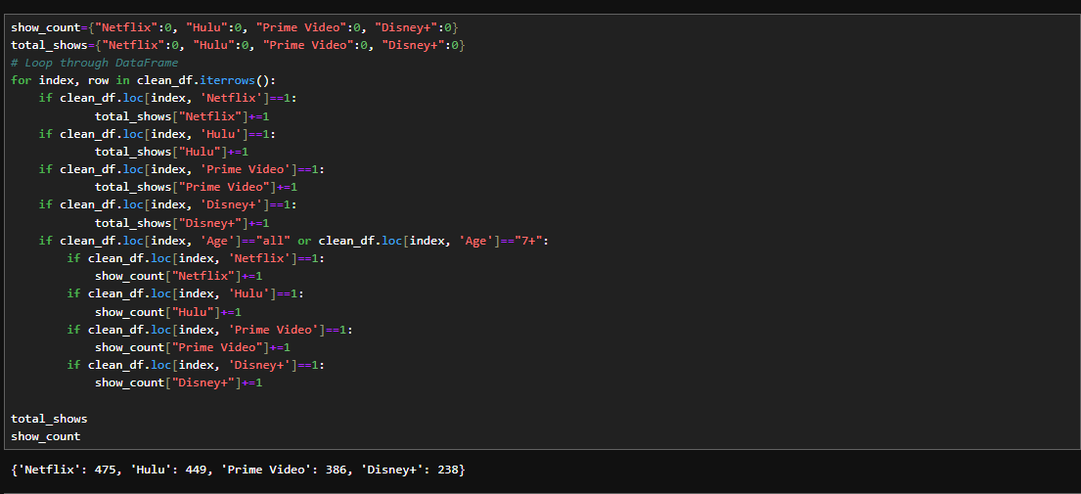
Approach-
Clean up dataframe after pulling it from CSV file by dropping entries with no “Age” value
Create dictionaries to hold counters and loop through dataframe, counting the total number of shows and how many are for ages “all” or “7+”
Calculate percentage of shows that are family friendly per service
Create visualizations using bar charts
Calculate percentage of shows that are family friendly per service
Create visualizations using bar charts

Slide 10
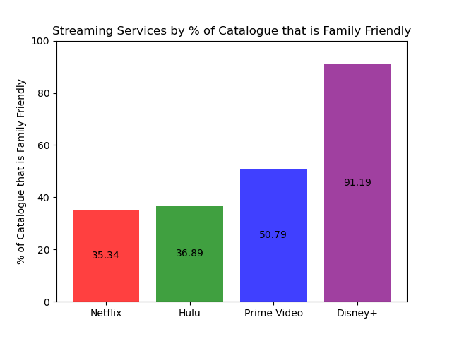
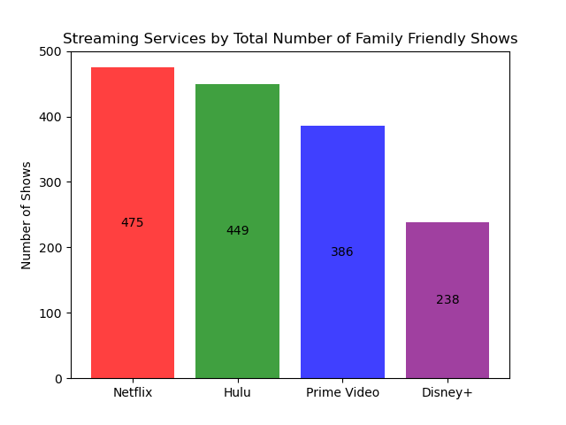
Results
The analysis of my data reveals that Disney+ has the highest percentage of shows on the platform that are family friendly, while Netflix, while having the lowest percentage of family friendly shows, has the most total family friendly shows. Therefore, if you are looking for a service that has primarily family friendly programming, Disney+ is the recommended streaming service. However, if you are looking for the most family friendly programming, Netflix is the recommended streaming service.

Slide 11
What service has the most highly rated shows?

Slide 12


What Service has the most highly rated show?
The result will be based on 2 different rating systems:
IMDb
Rotten Tomatoes

Slide 13
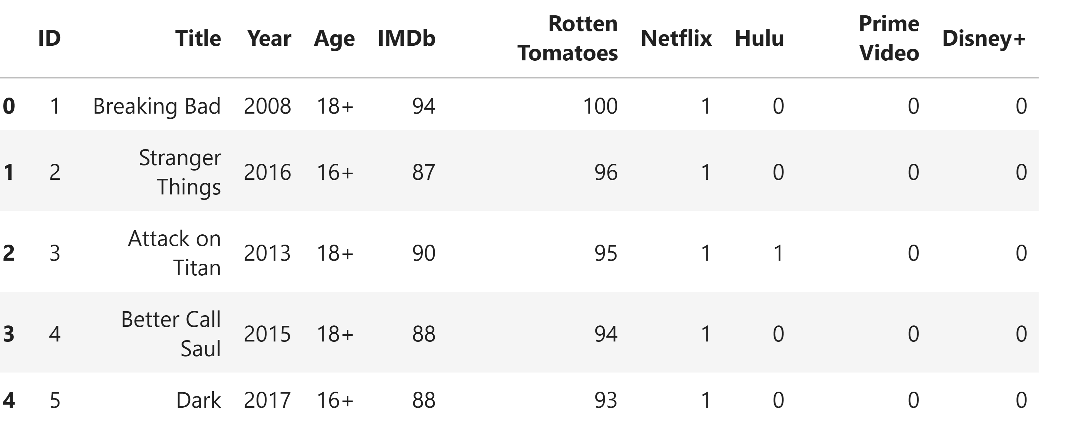
IMDb
Only pull data that greater than or equal to 80 on IMDb column:

Slide 14
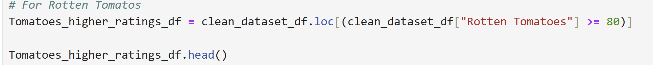
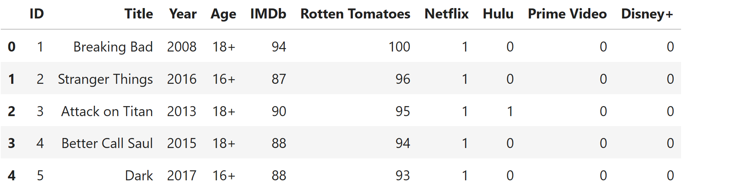
Rotten Tomatoes
Calculate the total TV shows on each service

Slide 15
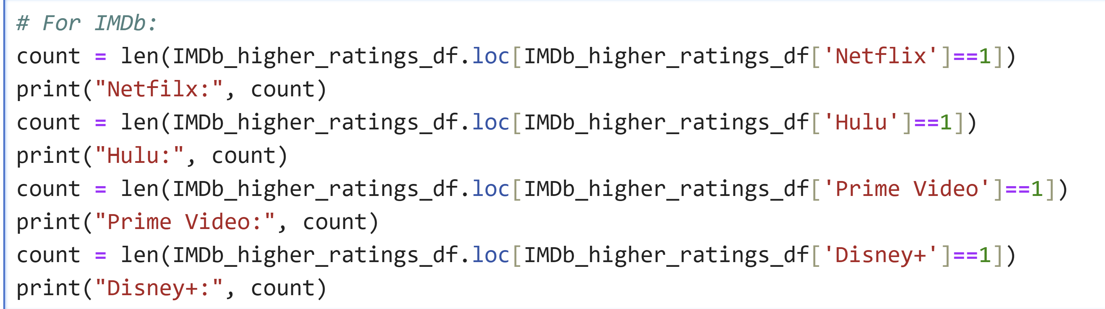
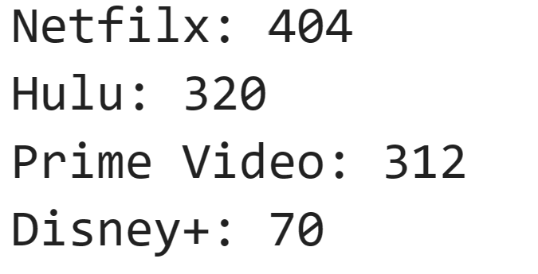
Calculate the total TV shows on each service based on IMDb
Coding:
Result:

Slide 16
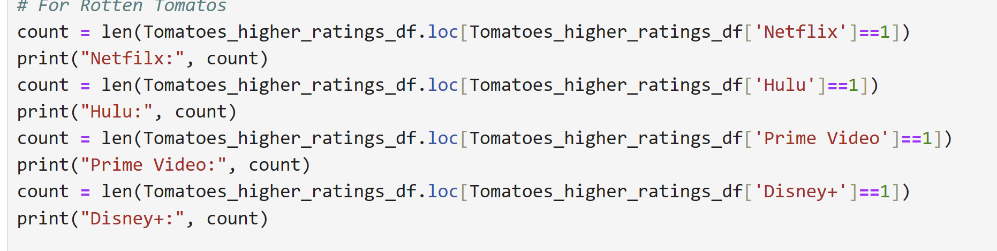
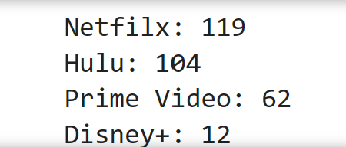
Calculate the total TV shows on each service based on Rotten Tomatoes
Coding:
Result:

Slide 17
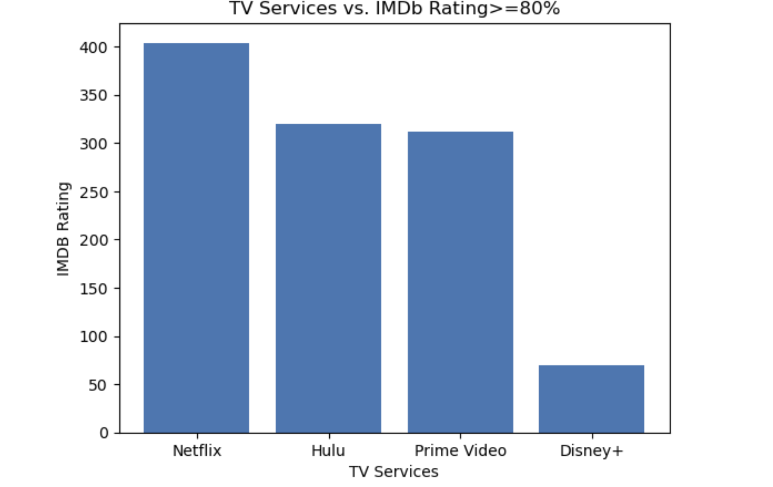
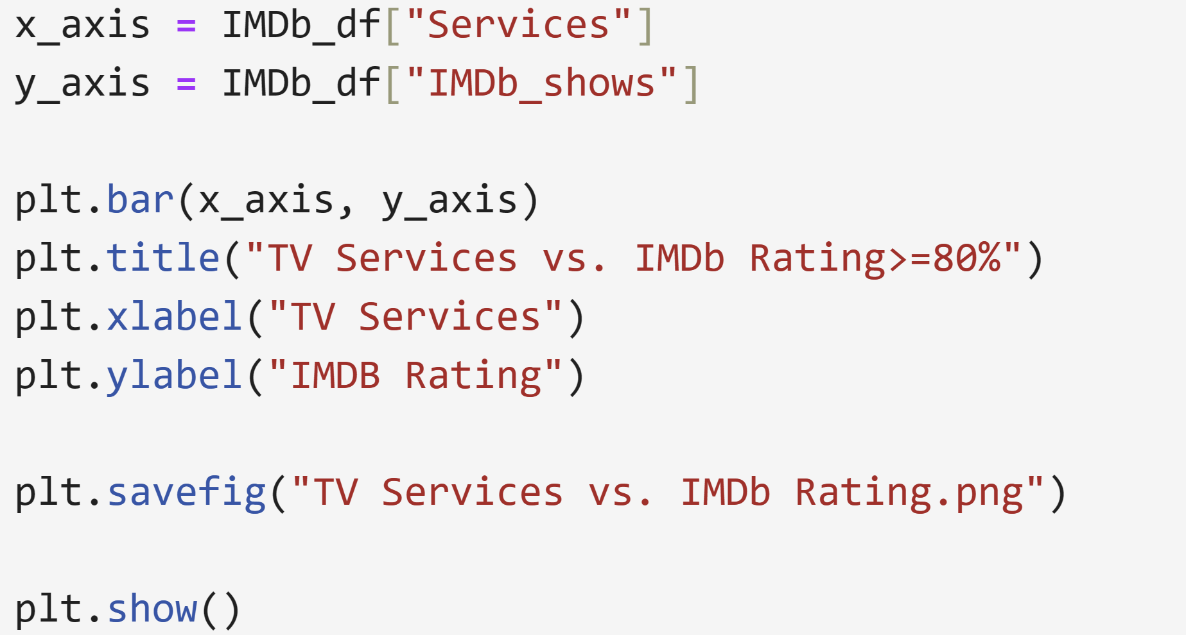
IMDb

Slide 18
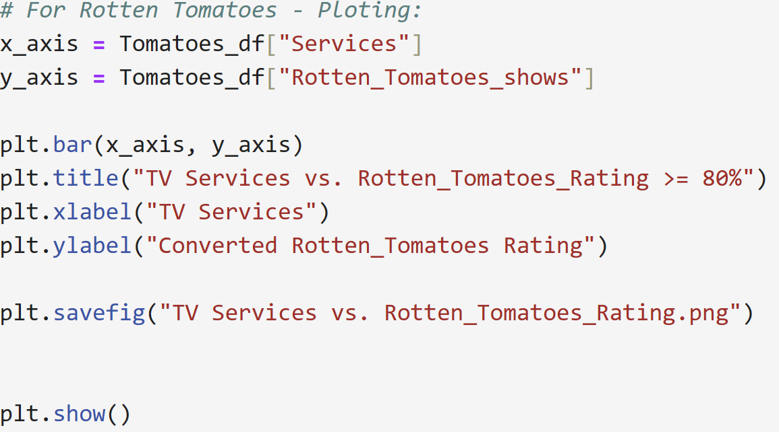
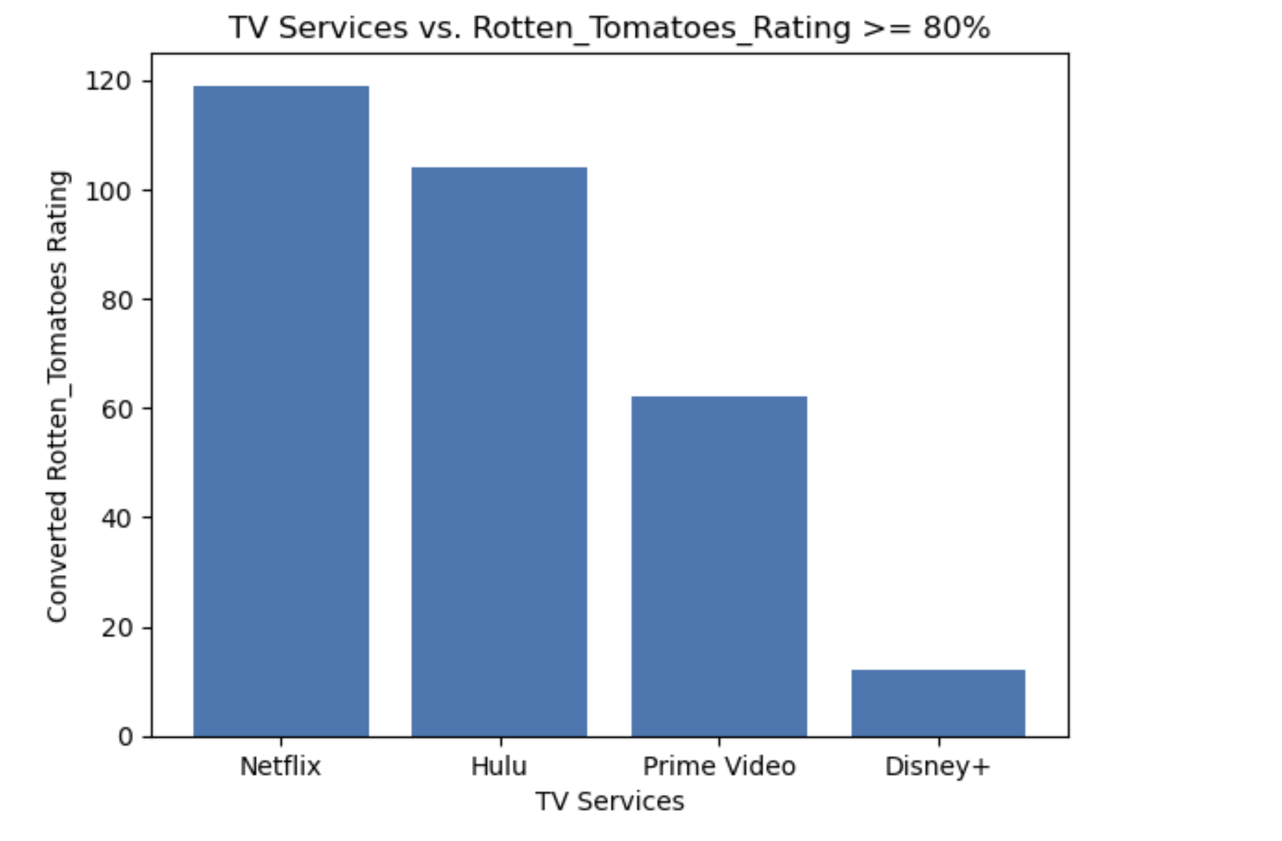
Rotten Tomatoes

Slide 19
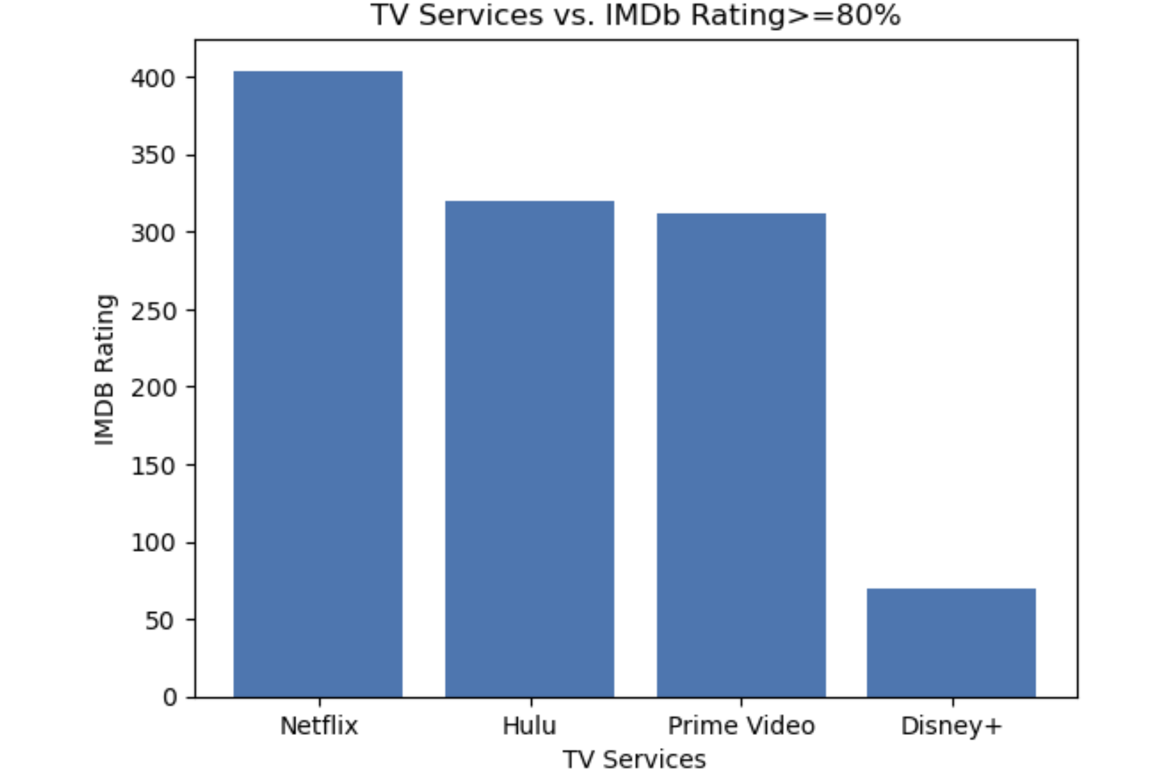
Who is the winner?

Slide 20
Which year(s) had the most highly rated shows?

Slide 21

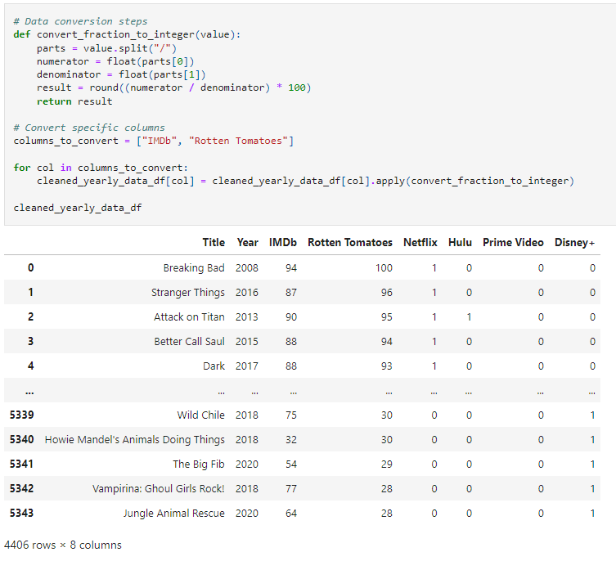
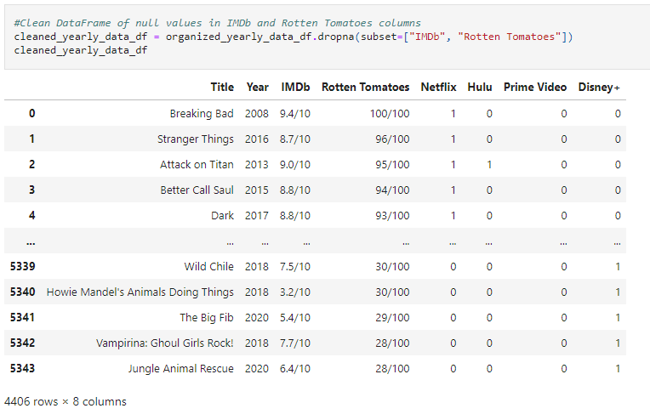
Approach – Modifying data
One important modification was from string data (involving a / ) in the rating information to integers for data analysis

Slide 22
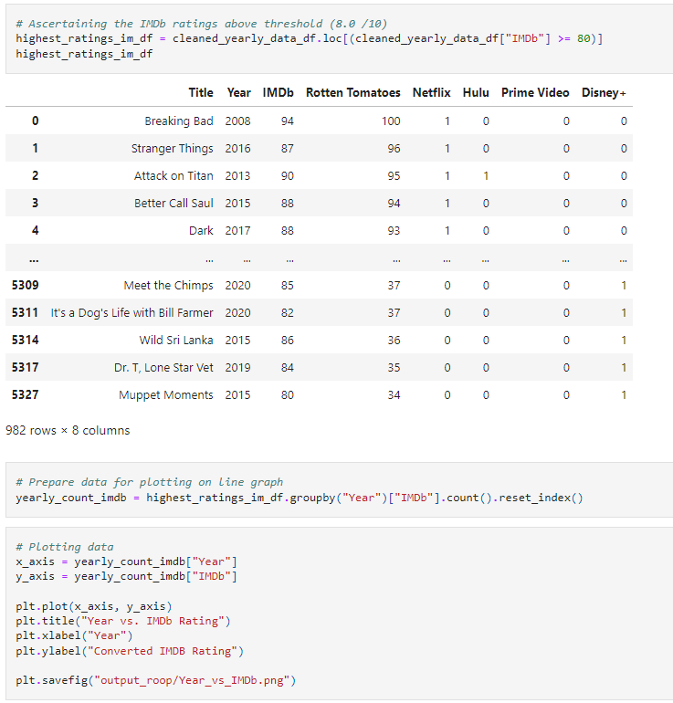
Approach
Filtering down to a specific score, which was decided amongst the team to be > 80 for each ratings system
Plotting a line graph to display the counts for each year to visualize the continuum of years covered in each line graph
Because these ratings systems cover different years, plotting two lines on one graph is complicated

Slide 23
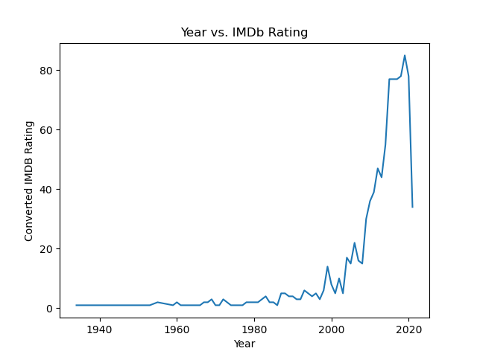


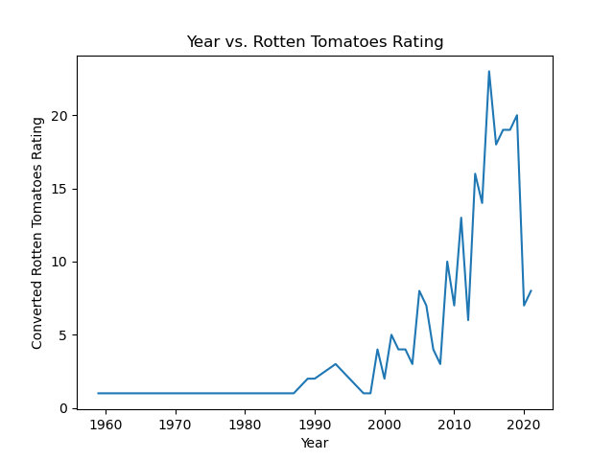
Results
IMDb’s year with the most highly rated shows is 2019:
in which they had 85 unique shows with an IMDb rating > 80 (or 80/100 in their system)
IMDb’s shows stretch back to 1934
Rotten Tomatoes’ year with the most highly rated shows is 2015
in which they had 23 unique shows with a Rotten Tomatoes rating > 8.0/10
Rotten Tomatoes’ shows date back to 1959
These differences highlight an important difference that will be discussed on the next slide

Slide 24
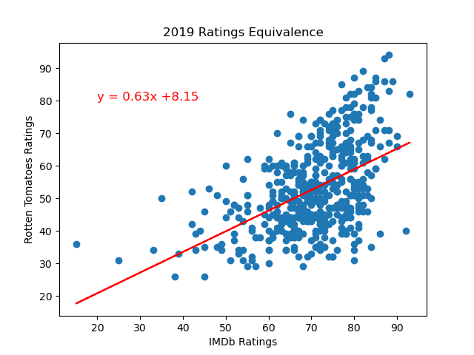
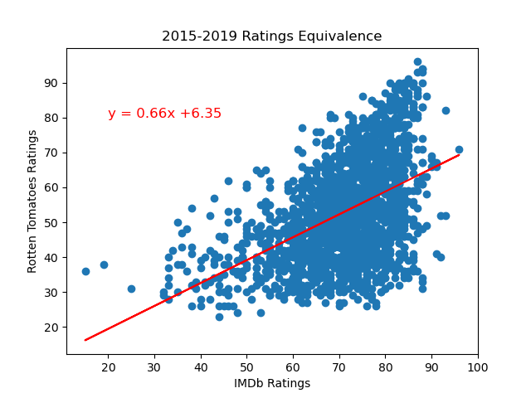
Equivalence
Using linear regression, we can determine that there is only a moderate amount of correlation as noted in r-values:
There are only modest association between IMDb ratings and Rotten Tomatoes ratings for:
2019 alone
2015-2019
Meaning not every IMDb rating represents its counterpart in Rotten Tomatoes
YOUR CHOICE MAY COME DOWN TO WHO YOU
BELIEVE MORE!

Slide 25
Next Steps
Expanding the scope to include more streaming services most likely by using an API-based approach
Asking additional questions to further our understanding of which streaming service may be best
The API would afford us the opportunity to ask further questions at much greater depth
Using current (2023-2024) data to analyze and confirm our findings
A more comprehensive initial dataset could allow for more testing, including hypothesis testing

